Slide 1
RUN – TIME ENVIRONMENTS

Slide 2
Run – Time Environments
Compiler must accurately implement
  The abstractions in the source language
    Names, Scopes and Bindings
    Data types and Operators
    Procedures and Parameters
    Flow of control constructs

Slide 3
Run – Time Environments
Compiler assumes its target programs are being executed in RTE
  Compiler creates and manages it.
The environment deals with a variety of issues
  The layout and allocation of storage location for the names in the source program
  Mechanism to access variables
  The linkage between procedures
  The mechanisms for passing parameters

Slide 4
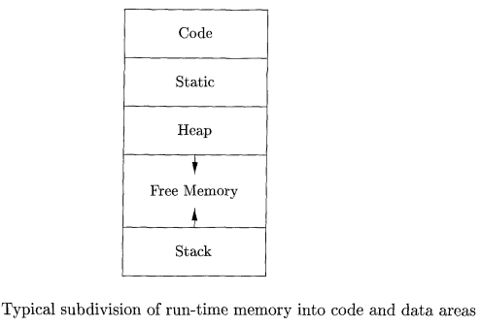
Storage Organizations
The executing target program runs in its own logical address space
The operating system maps this to physical address space

Slide 5
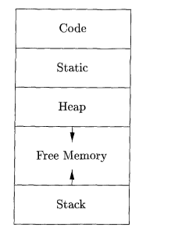
Storage Organizations
Generated executable code, size is fixed
Program data objects, sizes are known at compile time
The heap is used to manage long-lived data, generated by the programmer by allocating and deallocating memory
The stack is used to store data structures
called activation records that get generated during procedure calls.

Slide 6
Static Vs Dynamic Storage Allocation
Static: Can be determined at compile time
  Code segment
  Static Data segment
Dynamic : Can be decided only while the program is running
  Stack Storage
  Heap Storage

Slide 7
STACK ALLOCATION

Slide 8
Stack Allocation
Stack is used for procedures, functions, methods as part of their run time memory.
Each time a procedure is called –
  Space for its local variable is pushed onto stack
  At return time that space is popped off.
  Machine Status is saved
  Pass parameters and return values
An activation record is a data structure that holds all these information

Slide 9
Nesting of procedures
If an activation of procedure p calls procedure q then
  The activation of q must end before activation of p can end.
There are three common cases:
  Activation of q terminates normally
  Activation of q aborts
  Activation of q because of exceptions that q cannot handle

Slide 10
Stack Allocation:
Nested Procedure Call
What do you mean by nesting of procedure calls or activation of procedures???
It is like nested loops ..
  for(..) //1
  {
  ........ // in for 1
  for() //2
  {
  ........ In for 2
  for() //3
  {
  ................ In for 3
  }
  .............after for 3 / in for 2
  }
  ................after for 2/ in for 1
  }
for 3 must end before for 2
for 2 must end before for 1

Slide 11
Nesting of procedure
void do_task(int x, int y)
{
  int I;
  get_help();
  processing();
}
main()
{
  int m, n;
  read_input();
  do_task(m, n);
}
void get_help()
{
  int help;
  thinking();
  get_more_hlep();
  processing();
  help();
}
void get_more_help();
{
  dont_know();
}

Slide 12
Activation Record
Representing as a Tree
Activation Tree:
  Representation of procedures during the running of an entire program by a tree.
Each Node( p):
  Corresponds to one activation of a procedure
  Root: activation of the main procedure.
Each Children( q):
  Corresponds to activations of the procedures called by this activation of the node.
  q is called from p.
  Order from left to right.

Slide 13
Activation Tree
main()
read_input()
do_task(m,n)
get_help()
processing()
thinking()
processing()
get_more_help()
help()
dont_know()

Slide 14
Activation Tree
Several useful relationships between activation tree and behavior of the program
  Sequence of procedure calls corresponds to preorder traversal of the activation tree
  Return sequence corresponds to post order traversal
  At any node N the live activations are those that corresponds to N and its ancestor.

Slide 15
Activation Tree
main()
Already traversed
Alive procedure
read_input()
do_task(m,n)
Yet to call
get_help()
processing()
thinking()
processing()
get_more_help()
help()
dont_know()

Slide 16
Activation Records (AR)
Procedure calls and returns are managed by a run time stack: Control Stack
Each live activation has an activation record on the control stack
Root of the activation tree ( main proc) at the bottom.
Sequence of AR in the stack corresponds to path in the AT

Slide 17
Contents of AR
Temporary: to evaluate expressions
Local Data: belonging to the procedures
Saved machine status:
Access link: to locate data found in another activation
Control link: pointing to AR of the caller
Returned Value:
Actual Parameters: used by the calling procedure
Actual parameters
Returned values
Control Link
Access link
Saved machine status
Local Data
Temporaries
fig: A general activation record

Slide 18
Activation Record
Here the AR sequences in the control stack corresponds to the active procedures in the Activation Tree
AR for: main()
AR for: do_task()
AR for: get_help()
AR for: get_more_help()
AR for: dont_know()

Slide 19
Calling Sequences
When a procedure( q) is called from another procedure ( p)
  The AR for q must be created and inserted on top of AR of p.
  The sequences of code that do this task is called calling sequences
  It allocates an activation record in the stack and enters information into its field.

Slide 20
Calling Sequences
The code in a calling sequences is often divided between
  The calling procedure( “caller”)
  The called procedure ( “callee”)
But the exact division depends on
  The source language
  The target machine
  The operating system

Slide 21
Calling Sequences
When designing calling sequences and the layout of activation records following principles are helpful:
  Values communicated between caller and callee are generally placed at the beginning of the callee’s activation record.

Slide 22
Calling Sequences
  Fixed length items are placed in the middle.
    Control link, access link, machine status field.
  Items whose size may not be known early enough are placed at the end of the activation record.
    Local variables, temporaries
  We must locate top of the stack pointer
    It may point to the end of the fixed length fields
      Fixed offset to access fixed length
      Local/ temporary are above the top-of-stack

Slide 23
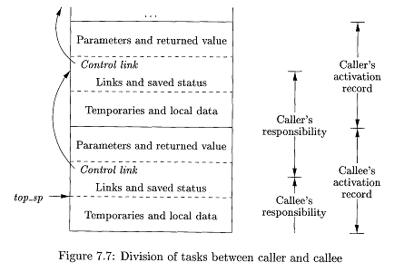
Task Division of Calling Sequences

Slide 24
Calling Sequences
The calling sequences and its division between caller and callee is:
  The caller evaluates the actual parameters
  The caller stores a return address and the old value of top_sp into callee’s AR
  It then increments top_sp to the position indicated in the previous figure
  The callee saves the register values and other status information
  The callee initializes its local data and begins execution

Slide 25
Return sequences
The callee places the return value next to the parameters
Use information in the machine-status field the callee restores the top_sp and other register
It branches to the return address that caller places in the status field
The caller knows where the return value is relative to the current top_sp .

Slide 26
Address-Layout
Code
Static
Heap
Free Memory
Stack
To hold the static Data.
Global variable.
To support function
or procedure call
Fig: Typical subdivision of run time memory into code and data areas

Slide 27
Contents of AR
Temporary: to evaluate expressions
Local Data: belonging to the procedures
Saved machine status:
Access link: to locate data found in another activation
Control link: pointing to AR of the caller
Returned Value:
Actual Parameters: used by the calling procedure
Actual parameters
Returned values
Control Link
Access link
Saved machine status
Local Data
Temporaries
fig: A general activation record

Slide 28
Access to non-local data on the stack
Non-local data: Used in procedure p but that does not belong to p.
Local data can be accessed from its own Activation Record.
But how can a function use non-local data

Slide 29
Data Access without Nested Procedures
Without Nested Procedures!!??
Calling sequence of procedures is always nested.
Here without Nested means declaration of functions is not nested.

Slide 30
Without Nested Procedures!!
Variables are defined either within
  Different functions – Local
  Outside any function – Global
Here it is impossible to
  Declare one procedure whose scope is entirely within another procedure.
All function can access a global variable and a local variable can be accessed by that function only
Example: C family of languages.

Slide 31
Without Nested Procedures!!
Allocation and access to variables are simple
  Global variables are allocated in the static storage
  Local variable must be reside in the current activation record which can be found at the top of the stack using top_sp pointer

Slide 32
Issues with Nested Procedures
Procedures declarations are nested.
  Declare one procedure in the scope of another
A procedure can access variables of the procedures
  Whose declarations surround its own declaration.

Slide 33
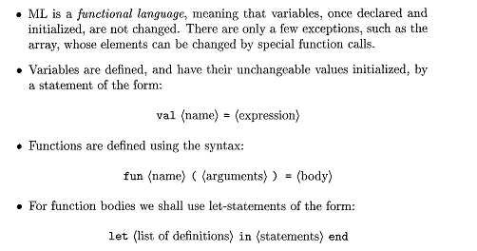
A Language with Nested Procedures Declarations: ML

Slide 34
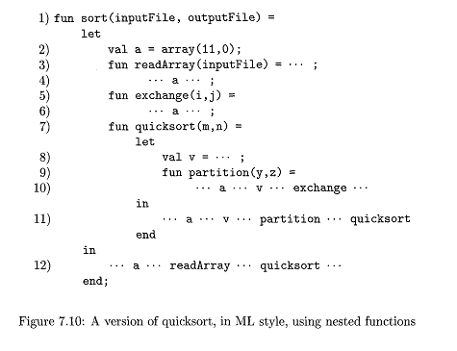
Examples

Slide 35
Nested Depth
If a procedure p is defined immediately within a procedure q then
  Nesting depth (p) = Nesting depth ( q) + 1

Slide 36
Access Link
To ease the access of data in nested procedure declaration access link is used.
If procedure p is nested immediately within procedure q then
  Access link in any activation of p points to the most recent activation of q.
  Nesting depth of q must be exactly one less than that of p

Slide 37
Manipulating Access Link
How are access links determined??
Let procedure q calls a procedure p
There are three cases to consider.
  Procedure p is at a higher nesting depth than q
    Access link from p must point to q.
  The call is recursive, that is, p =q
    Access link of p is the same as that of q. Just copy it.
  The nesting depth of p is less than that of q (n_{p}<n_{q})
    There must be a function r that contains both of them
    Access link of p point to AR of r.

Slide 38
Examples

Slide 39
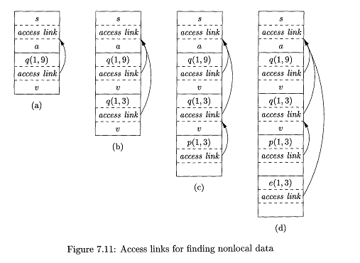
Examples

Slide 40
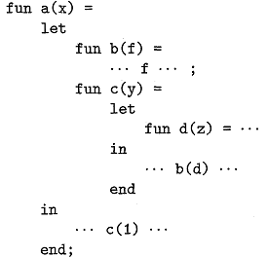
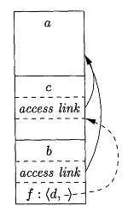
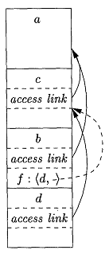
Access Links for Procedure Parameter

Slide 41
Summary
Activation tree: nesting structure of procedure call
Activation records: run-time memory to keep the records needed by the caller callee procedure.
Calling sequences: code sequences to populate and store these AR in the control stack at run-time.

Slide 42
Thanks

